Slide 1

Usability Test for Wix

Slide 2
Wix is a cloud-based web development platform designed to make websites development really easy.

Slide 3
3 Tasks that is Important to the Application
Task 1: Selecting a website Type
Task 2 : Designing and Writing down the content.
Task 3 : Publishing the website online.

Slide 4
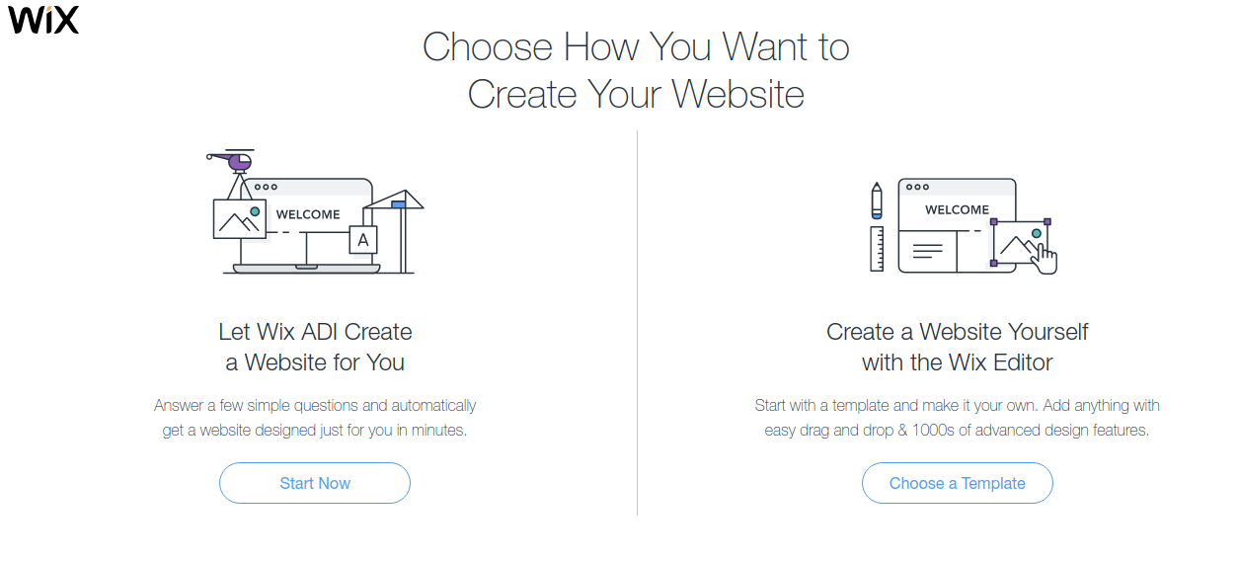
Task 1 : Selecting the website Type

Slide 5
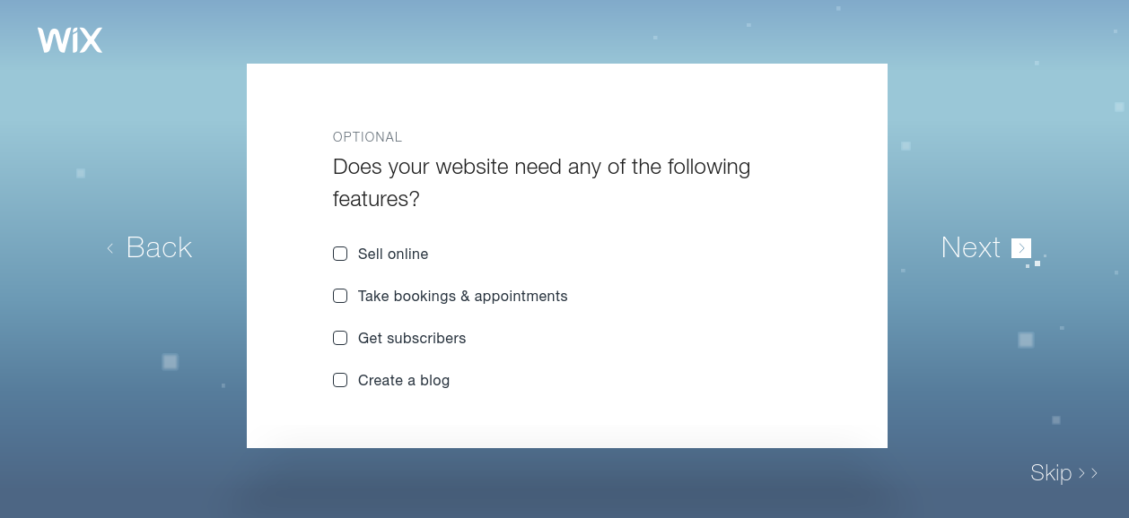
Task 2 : Putting in content

Slide 6
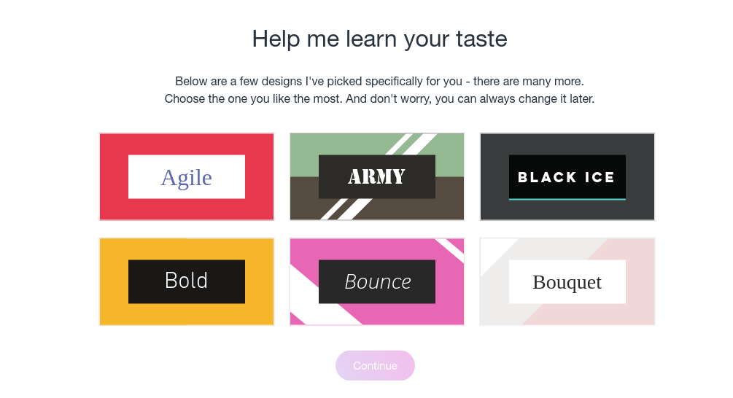
Task 3 : Publishing

Slide 7
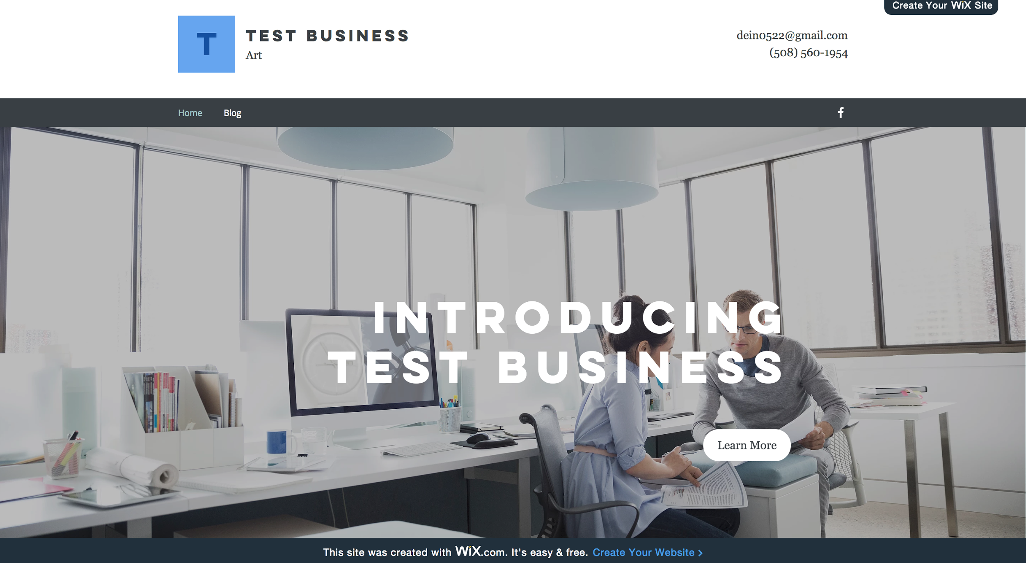
Task 3: Publish the website online

Slide 8
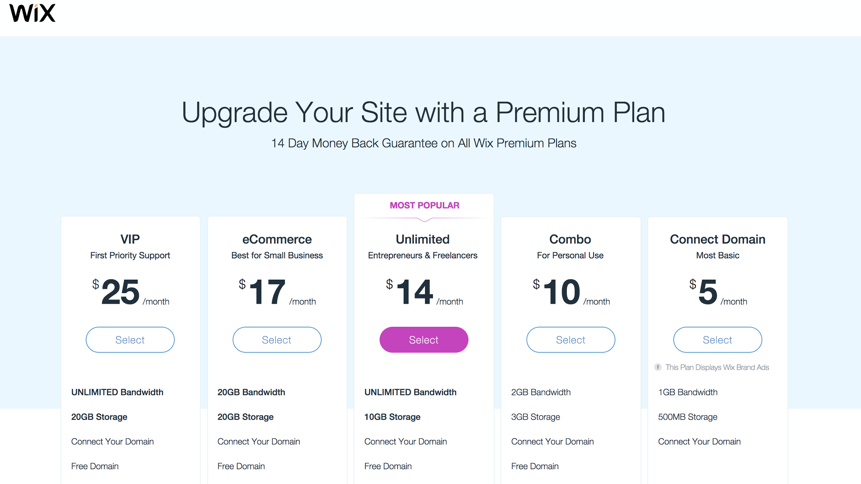
Buying your own Domain

Slide 9
Summary
Good interface
User Friendly Design
New Experience with the Design AI

Slide 10
Thank you

